Slide 1
New NSW Geography syllabus 7-10

Slide 2
Why teach geography?
…and don’t say “...because I have to...”

Slide 3
Teaching geography
Why is it important to teach geography?
How do you develop student interest in, and engagement with geography?
What is the purpose of geographical inquiry in developing students’ interest in, and engagement with, geography?
What do students gain from the study of geography?

Slide 4
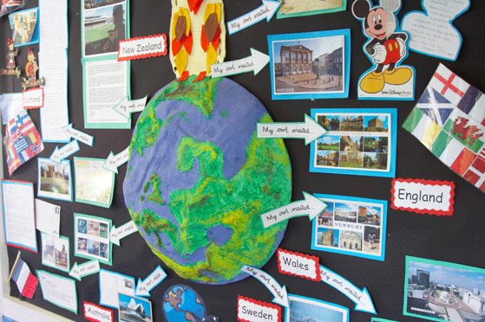
Geography in Primary – so what?
For the first time, Geography as a stand alone subject will be taught in primary school. It will take a few years before the impact of this is fully realised.

Slide 5
Geography in Primary – so what?
As a result of students undertaking Geography in primary school they will have:
Investigated geographical concepts (generally lower-order)
Used geographical tools such as large and small scale maps, different types of maps, satellite images, GPS, photographs, illustrations, annotated diagrams, used fieldwork instruments.
Conducting geographical inquiries: acquired, processed and communicated geographical information.

Slide 6
Geography in Primary – so what?
Traditional elements used to introduce Geography now may not be as appropriate as they are now. For example:
Starting Year 7 with “What is Geography?”
Providing an introduction to maps, and associated skills in Year 7.
Introducing fieldwork in Year 7.
Each of these will still need to be covered in Year 7, but you will actually be building on prior knowledge from primary school rather than introducing them for the first time.

Slide 7
Continuums of learning
How will I know students’ prior knowledge?
The continuums map the levels of development that students will reach in each stage . There are three separate continuums:
Geographical concepts p 26-7
Inquiry skills p 30-31
Geographical tools p34
These continuums include learning in both primary school and secondary school.
It is obviously still a good idea to undertake pre-testing to get an accurate picture of what your students have actually achieved.

Slide 8
Geographical Concepts
Place - the significance of places and what they are like
Space -the significance of location and spatial distribution, and ways people organise and manage the spaces that we live in
Environment - the significance of the environment in human life, and the important interrelationships between humans and the environment
Interconnection - no object of geographical study can be viewed in isolation
Scale - the way that geographical phenomena and problems can be examined at different spatial levels
Sustainability - the capacity of the environment to continue to support our lives and the lives of other living creatures into the future
Change - explaining geographical phenomena by investigating how they have developed over time
Examine page 22 to explore the differences in expectations for Stage 4 and 5.

Slide 9
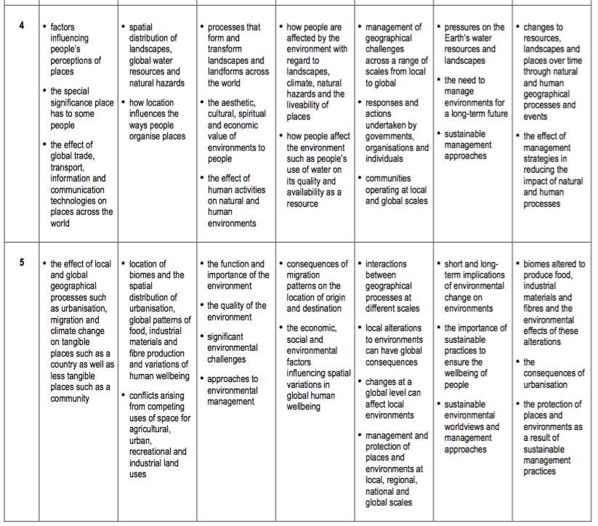

Slide 10
Geographical Inquiry Skills
Acquiring Geographical Information
Processing geographical information
Communicating geographical information
Examine page 25 to explore the differences in expectation for Stage 4 and 5.

Slide 11
Geographical Inquiry Skills
How could you use the Geographical Inquiry continuum to develop the use of geographical skills with your students?
How will your knowledge of how students have developed their geographical skills in primary, change the way you teach geography in 7-10?

Slide 12
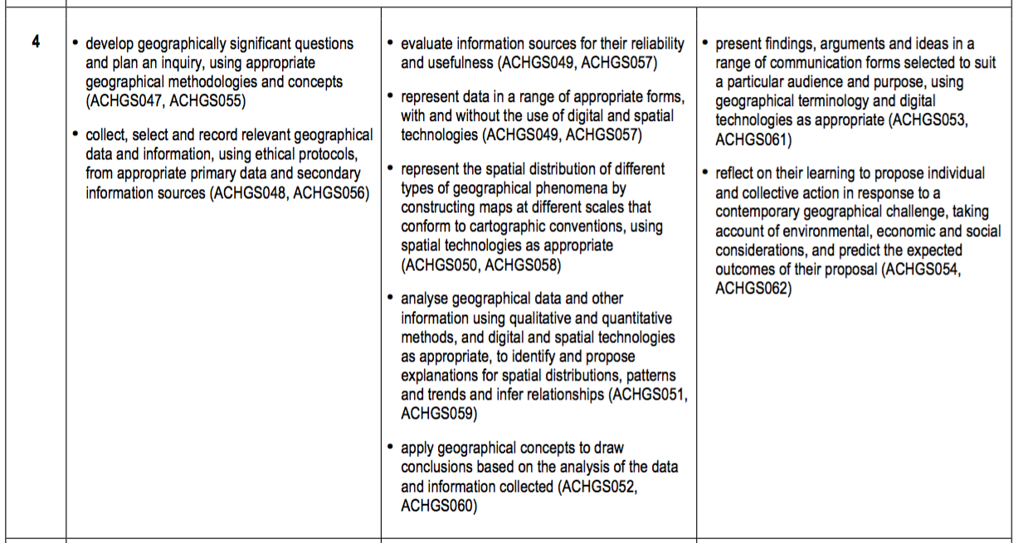

Slide 13
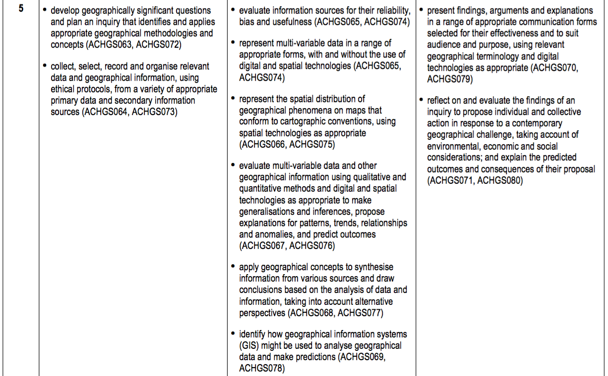

Slide 14
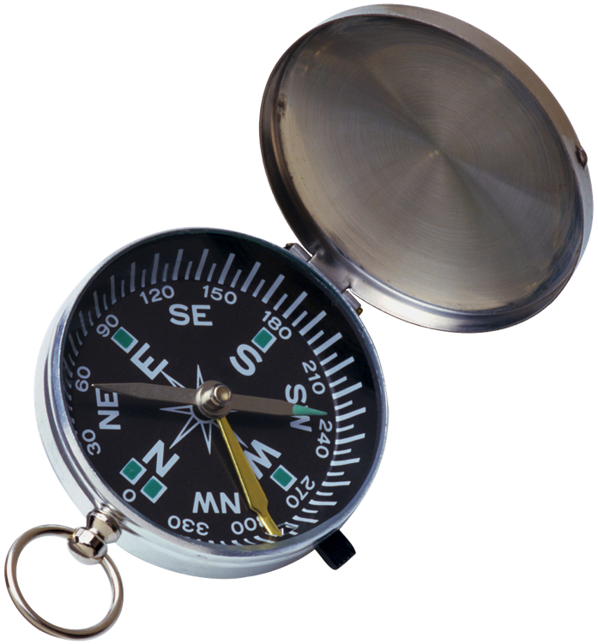
Geographical Tools
Maps
Fieldwork
Graphs and Statistics
Spatial Technologies
Visual Representations
Examine page 29 to explore the difference in expectations for Stage 4 and 5. How comfortable are you with these tools? What tools will you need to learn or revise?

Slide 15
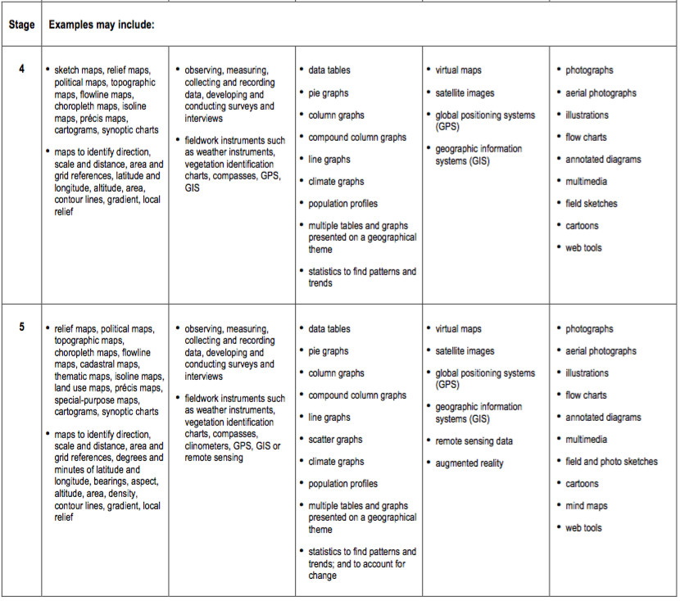

Slide 16
Outcomes, stage statements and content
What are we actually teaching?

Slide 17
Outcomes – what do we want students to be able to do?
Outcomes describe the essential learning that MUST happen.
These are the starting points for designing your lessons, excursions and assessments.
It is important to determine which outcomes you are going to report on at the beginning of the year, to ensure that your lessons and assessments accurately relate to the outcomes, and aren’t just an afterthought.
When designing your assessment tasks ensure that they don’t overly emphasise the content, but are aimed at demonstrating achievement of the outcomes through the content.

Slide 18
Outcomes – what do we want students to be able to do?
Stage 4:
GE4-1 locates and describes the diverse features and characteristics of a range of places and environments
GE4-2 describes processes and influences that form and transform places and environments
GE4-3 explains how interactions and connections between people, places and environments result in change
GE4-4 examines perspectives of people and organisations on a range of geographical issues
GE4-5 discusses management of places and environments for their sustainability
GE4-6 explains differences in human wellbeing
- Directly from the BOSTES website

Slide 19
Outcomes – what do we want students to be able to do?
Stage 5:
GE5-1 explains the diverse features and characteristics of a range of places and environments
GE5-2 explains processes and influences that form and transform places and environments
GE5-3 analyses the effect of interactions and connections between people, places and environments
GE5-4 accounts for perspectives of people and organisations on a range of geographical issues
GE5-5 assesses management strategies for places and environments for their sustainability
GE5-6 analyses differences in human wellbeing and ways to improve human wellbeing
- Directly from the BOSTEs website.

Slide 20
Stage statements
Stage statements provide a description of what we want students to have achieved by the end of the stage.
They summarise content knowledge, skills, values and attitudes.
Use the stage statements to shape assessment tasks.
Use stage statements as a reference point for student achievement.

Slide 21
Stage statements – Stage 4
By the end of Stage 4, students describe geographical processes that influence the features and characteristics of places and environments across a range of scales. They describe how places are perceived and valued differently and explain interconnections within environments and between people, places and environments. Students investigate environmental change and differences in human wellbeing and discuss strategies for addressing geographical challenges, taking into account environmental, economic and social factors.
Students undertake geographical inquiry to build knowledge and understanding of people, places and environments through the collection, collation and analysis of primary data and secondary information. Students propose explanations for spatial distributions, patterns and trends and infer relationships. They propose solutions, and may take action to address contemporary geographical challenges and predict outcomes. Students participate in fieldwork to collect primary data and develop their personal capabilities and workplace skills.
- Directly from the BOSTES website

Slide 22
Stage statements – Stage 5
By the end of Stage 5, students explain geographical processes that change features and characteristics of places and environments over time and across scales and explain the likely consequences of these changes. They analyse interconnections between people, places and environments and propose explanations for distributions, patterns and spatial variations over time and across scales. Students compare changing environments, analyse global differences in human wellbeing, explore alternative views to geographical challenges and assess strategies to address challenges using environmental, social and economic criteria.
Students undertake geographical inquiry to extend knowledge and understanding, and make generalisations and inferences about people, places and environments through the collection, analysis and evaluation of primary data and secondary information. They propose explanations for significant patterns, trends, relationships and anomalies in geographical phenomena. Students propose solutions, and may take action to address contemporary geographical challenges, taking into account alternative points of view and predicted outcomes. Students participate in relevant fieldwork to collect primary data and enhance their personal capabilities and workplace skills.
- Directly from the BOSTES website

Slide 23
Content - Topics
Stage 4
Landscapes and Landforms
Place and Liveability
Water in the World
Interconnections
Stage 5
Sustainable Biomes
Changing Places
Environmental Change and Management
Human Wellbeing

Slide 24
Are there some existing resources you can draw on from the current syllabus?
The next slides provide some examples of where there is a little bit of cross over between the current topics and new topics. Be careful to change key terminology and be sure that any old resources actually address the new outcomes and content. You may be able to use them as a base, but chances are you will need to make modifications.

Slide 25
Content - Topics
Stage 4
Landscapes and Landforms
Place and Liveability
Water in the World
Interconnections
Similar to existing topics….
Global Environments
Global Issues and the Role of Citizenship
Global Environments
Global Change

Slide 26
Content - Topics
Similar existing topic…
Issues in Australian Environments
Global Change
Issues in Australian Environments
Australia in it’s Regional and Global Context
Stage 5
Sustainable Biomes
Changing Places
Environmental Change and Management
Human Wellbeing

Slide 27
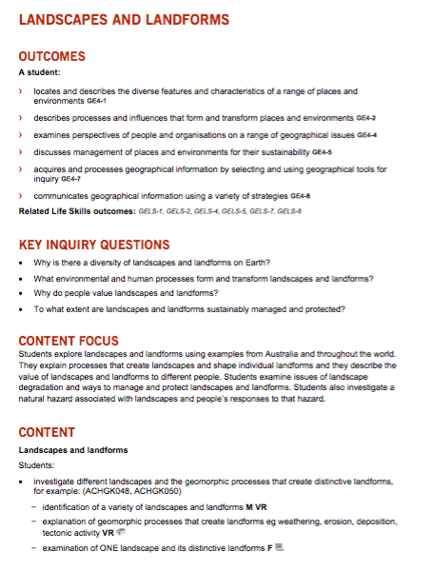
Content
Syllabus structure
Outcomes – Statements outlining what we want to students to be able to do
Key Inquiry Questions – Questions to drive students’ investigations.
Content Focus – A paragraph outlining the key objectives of the topic.
Content – The detailed information to be covered (dot points compulsory, dash points optional)

Slide 28
Related Life Skills outcomes are listed with the mainstream outcomes.
There is a separate Life Skills course at the back of the document. Unlike previous syllabuses,
The Life Skills course follows the same topics as the mainstream course. This will make it
easier to manage both your mainstream class and Life Skills students at the same time.

Slide 29
Australian Curriculum codes. (As a teacher, you don’t really need to worry about these, unless you are looking at resources developed in other states.)
Icons indicate the tools
(formerly skills) to be covered.
Icons indicate the Learning
Across the Curriculum to be covered.

